Slide 1

Salon Management System
A Web-Based Application for Managing Salon Services and Staff
By Bisma

Slide 2
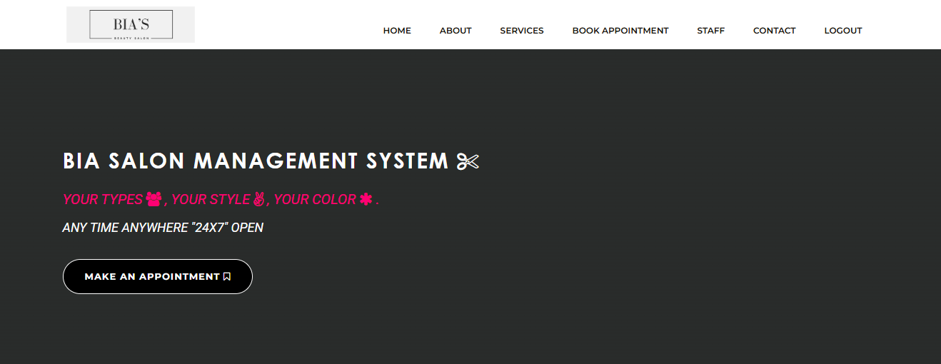
Goal: To build a user-friendly and efficient salon management platform for administrators to manage services, staff, and appointments.
Key Modules:
Service Management Admin Authentication Dashboard Staff Management

Slide 3
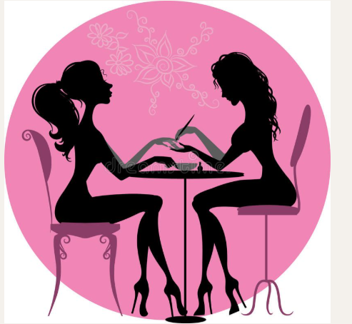
Technology Stack
Frontend:
HTML
CSS
Bootstrap
Backend:
PHP
Database:
MySQL
Server:
XAMPP (Apache + MySQL)

Slide 4
System Features
Admin Login
Secure admin login via username and password
ADD/Manage Services
Add and manage new services: name, description, cost
ADD/Manage Staff
Add and manage staff: name and specialty
Book Appointments
Book Appointments online or by admin.
Dashboard
Showing all appointments

Slide 5
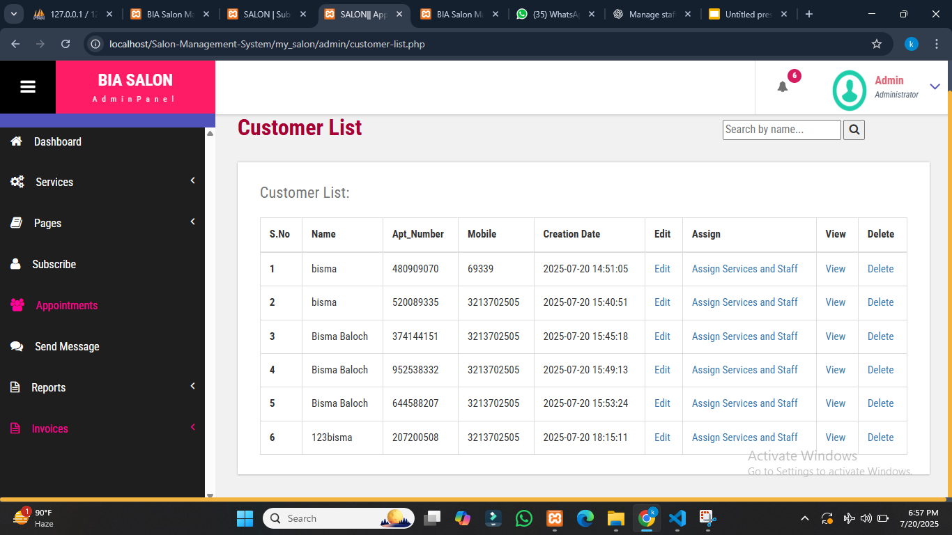
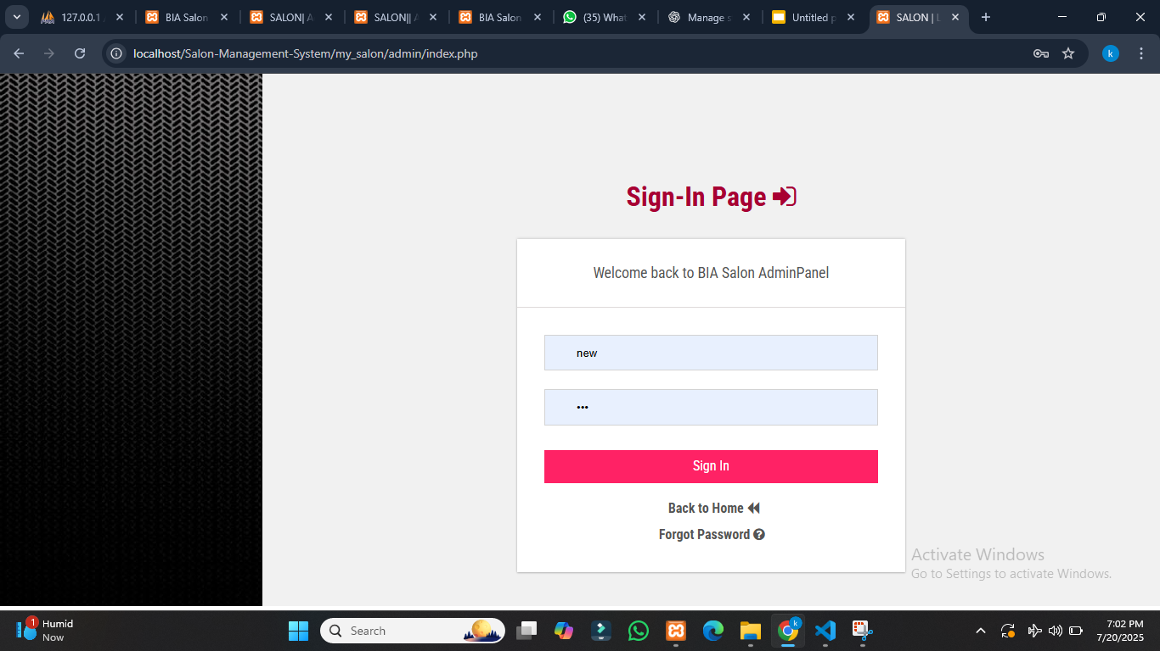
Appointments Dashboard
Admin
Login
page

Slide 6
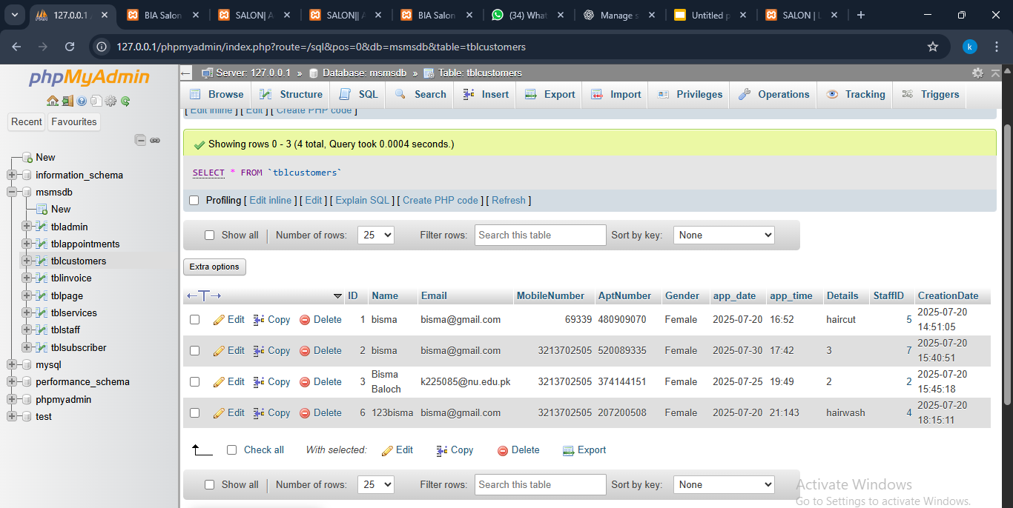
DATABASE

Slide 7
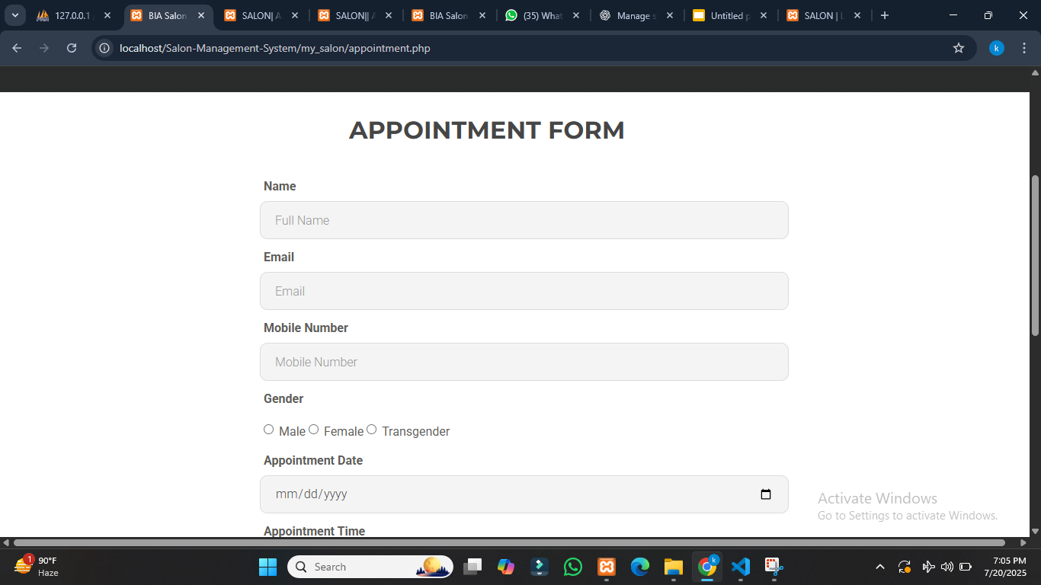

Slide 8
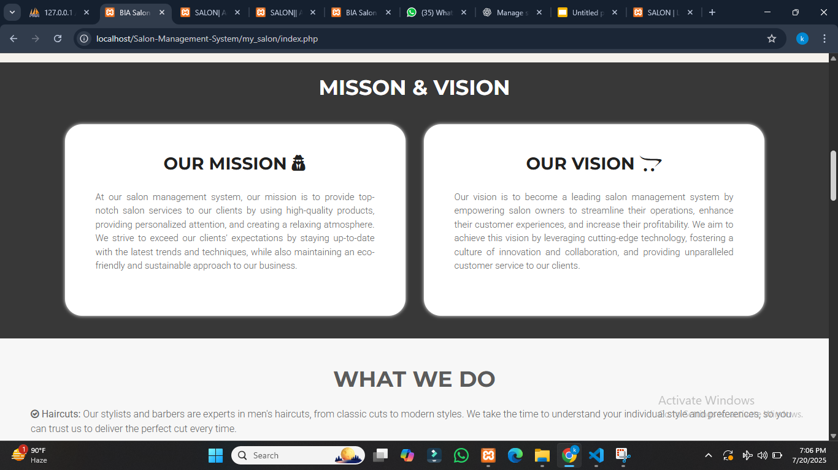

Slide 9
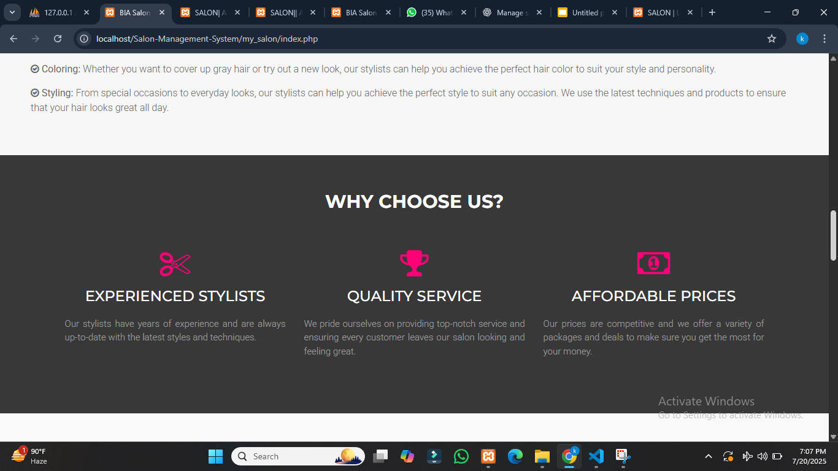

Slide 10
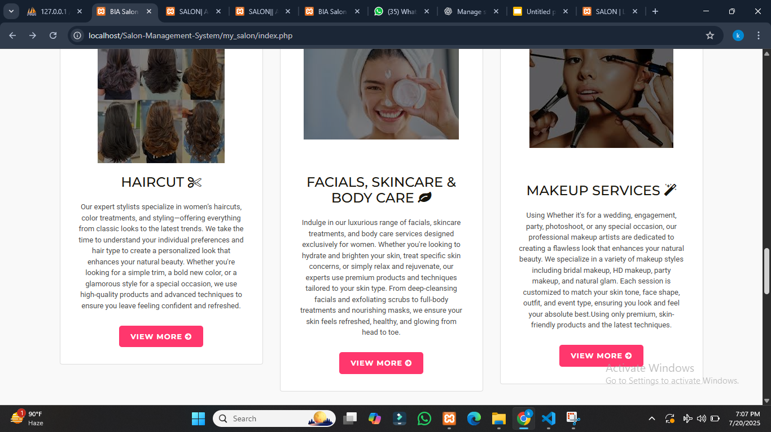

Slide 11
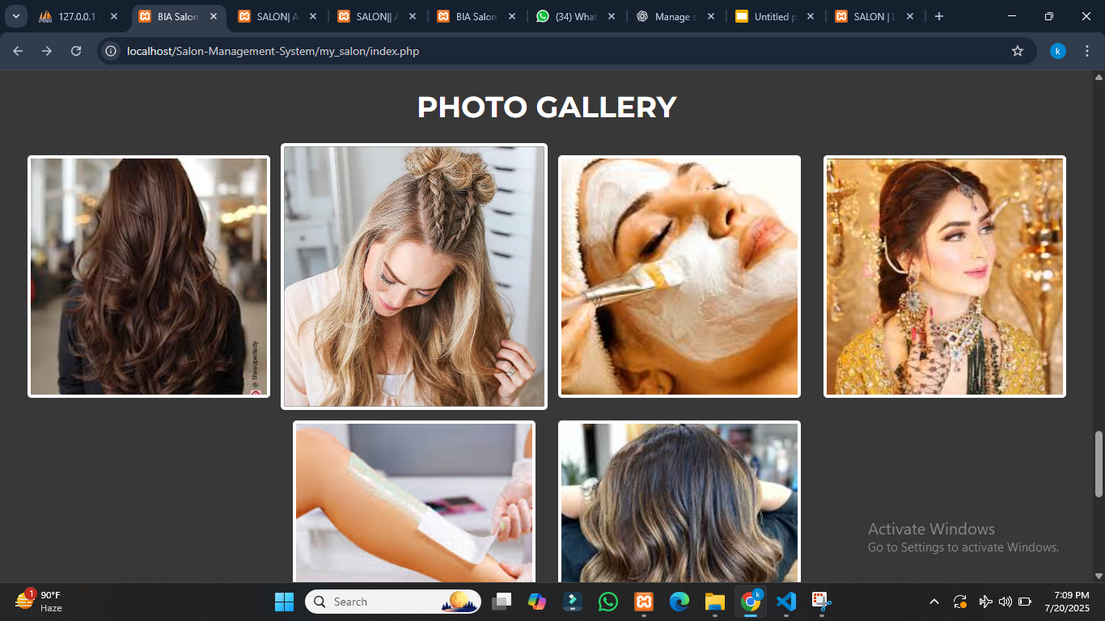

Slide 12
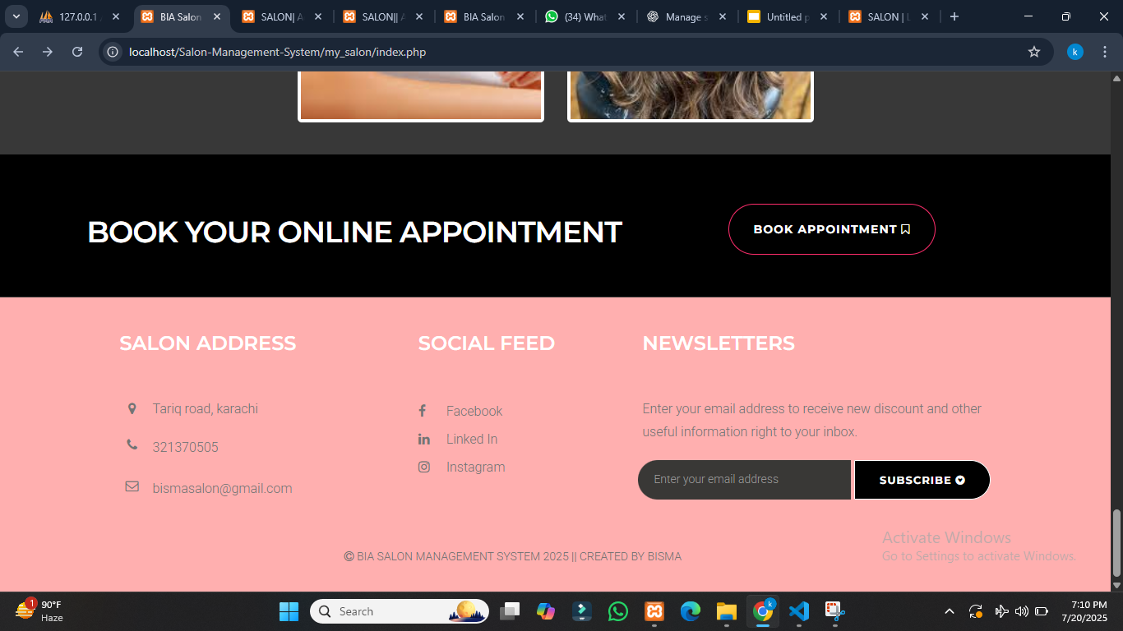

Slide 13
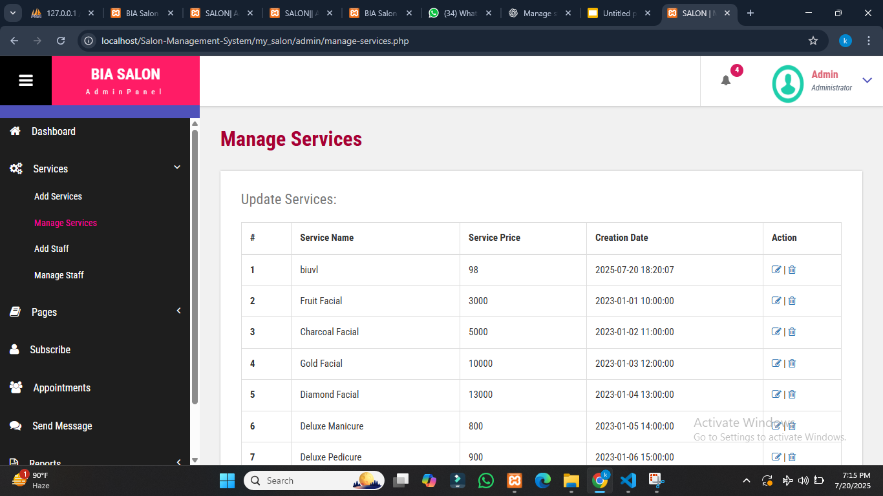

Slide 14
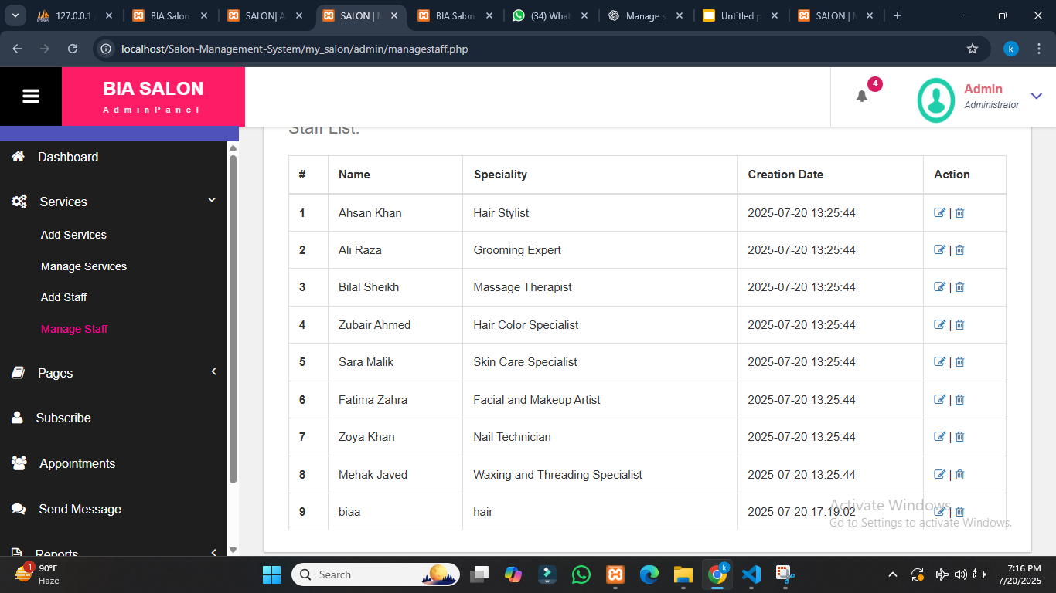

Slide 15
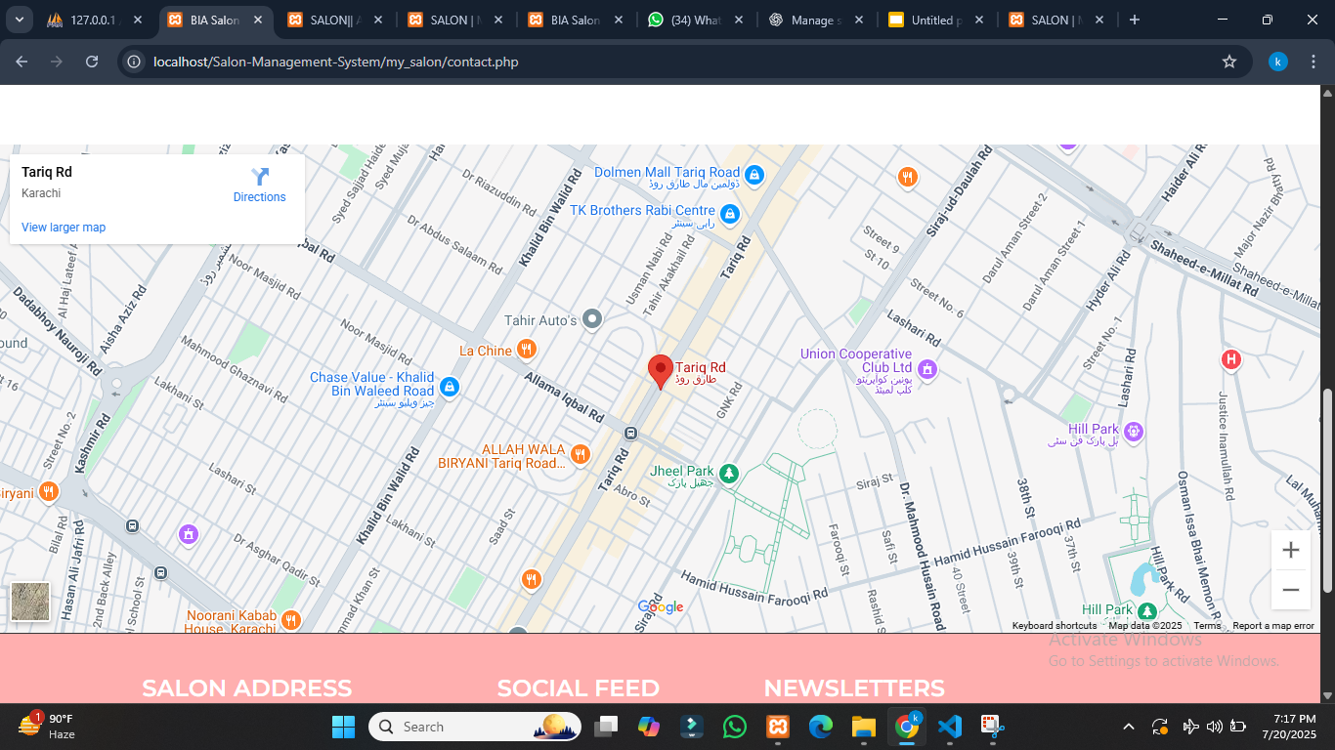
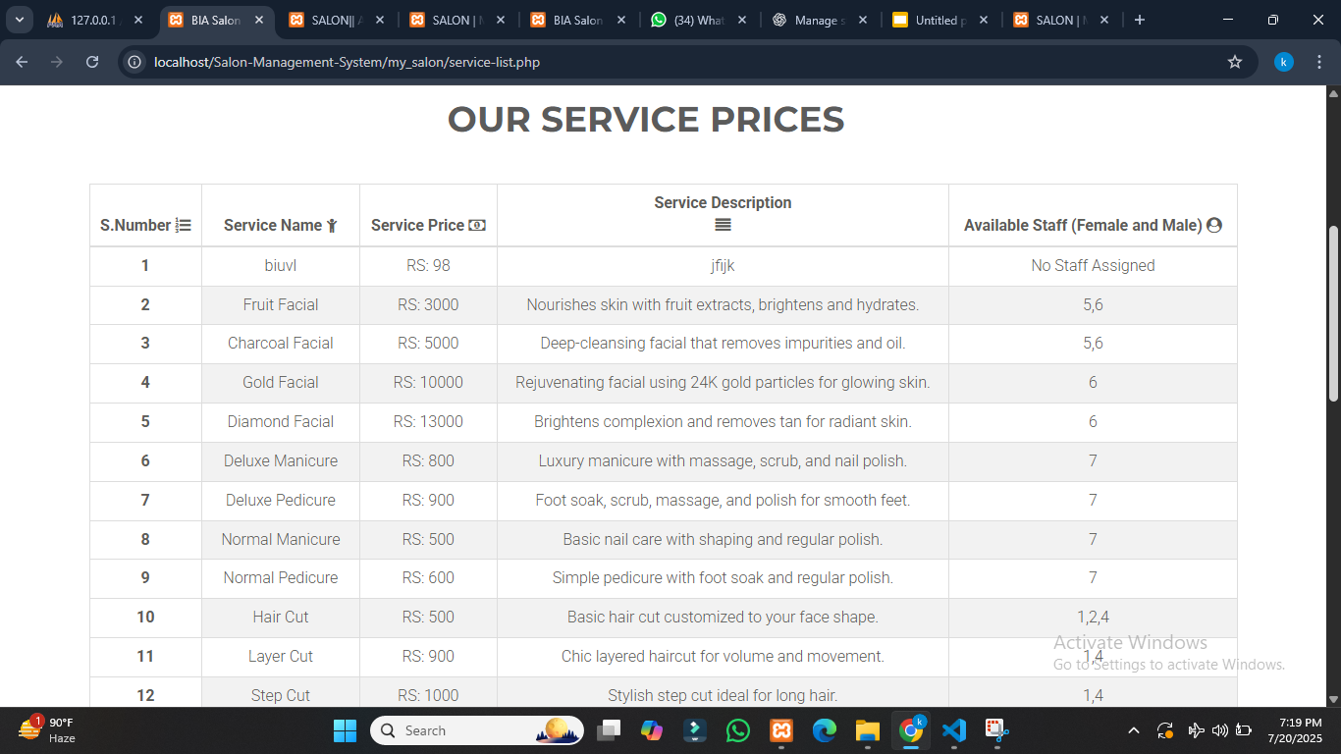
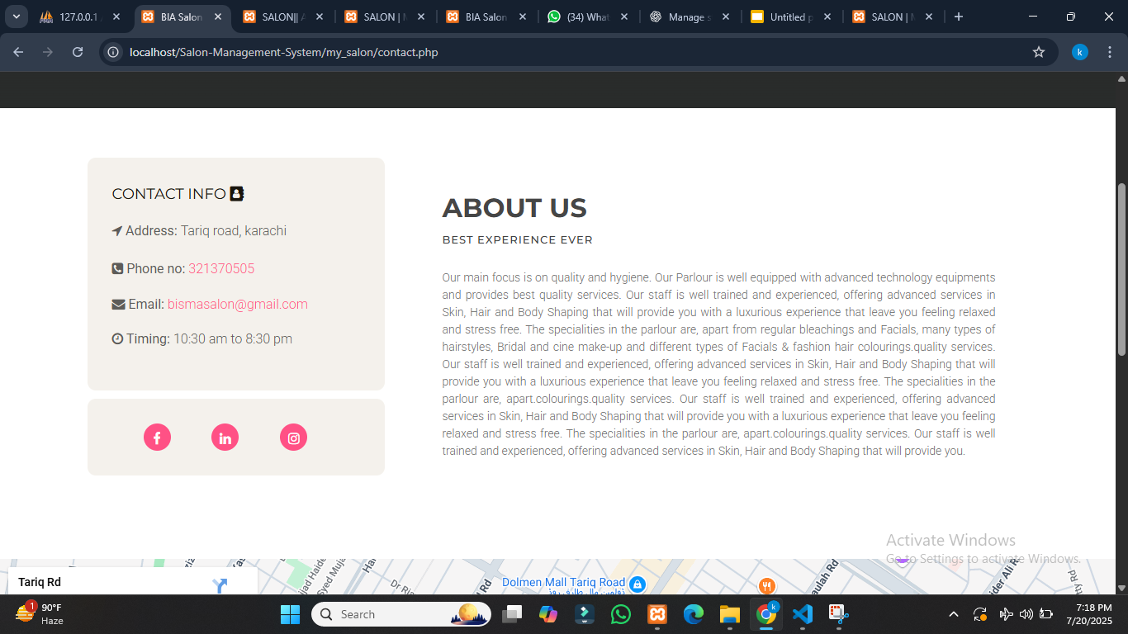
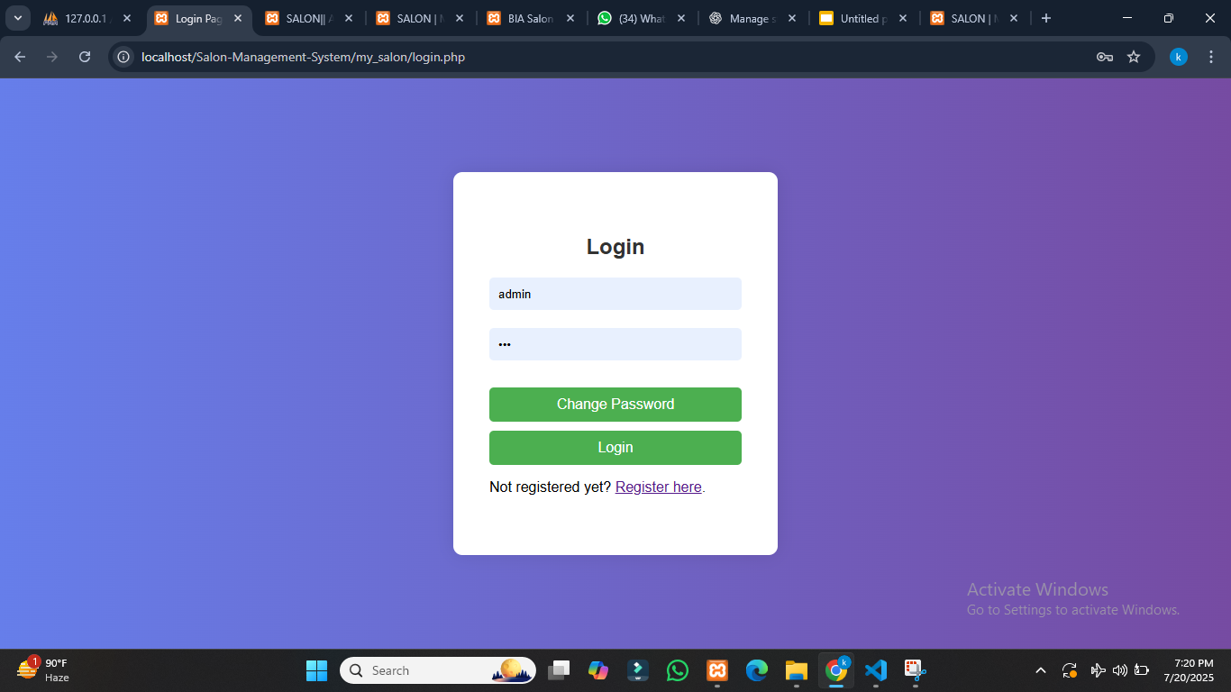

Slide 16
Future Enhancements
Customer Registration & Appointment Booking
Email/SMS Notifications
Role-based Access (Admin, Receptionist)
Monthly Reports & Service Analytics
Payment Integration

Slide 17
Conclusion
Successfully built a dynamic web app using PHP & MySQL
Improved understanding of CRUD, forms, sessions, and DB design
Useful for small to mid-sized salons

